Slide 1

Testing & modeling users

Slide 2
The aims
Describe how to do user testing.
Discuss the differences between user testing, usability testing and research experiments.
Discuss the role of user testing in usability testing.
Discuss how to design simple experiments.
Describe GOMS, the keystroke level model, Fitts’ law and discuss when these techniques are useful.
Describe how to do a keystroke level analysis.

Slide 3
Experiments, user testing & usability testing
Experiments test hypotheses to discover new knowledge by investigating the relationship between two or more things – i.e., variables.
User testing is applied experimentation in which developers check that the system being developed is usable by the intended user population for their tasks.
Usability testing uses a combination of techniques, including user testing & user satisfaction questionnaires.

Slide 4
User testing is not research
User testing
Aim: improve products
Few participants
Results inform design
Not perfectly replicable
Controlled conditions
Procedure planned
Results reported to developers
Research experiments
Aim: discover knowledge
Many participants
Results validated statistically
Replicable
Strongly controlled conditions
Experimental design
Scientific paper reports results to community

Slide 5
User testing
Goals & questions focus on how well users perform tasks with the product
Comparison of products or prototypes common
Major part of usability testing
Focus is on time to complete task & number & type of errors
Informed by video & interaction logging
User satisfaction questionnaires provide data about users’ opinions

Slide 6
Testing conditions
Usability lab or other controlled space
Major emphasis on
- selecting representative users
- developing representative tasks
5-10 users typically selected
Tasks usually last no more than 30 minutes
The test conditions should be the same for every participant
Informed consent form explains ethical issues

Slide 7
Type of data (Wilson & Wixon, ‘97)
Time to complete a task
Time to complete a task after a specified time away from the product
Number and type of errors per task
Number of errors per unit of time
Number of navigations to online help or manuals
Number of users making a particular error
Number of users completing task successfully

Slide 8
Usability engineering orientation
Current level of performance
Minimum acceptable level of performance
Target level of performance

Slide 9
How many participants is enough for user testing?
The number is largely a practical issue
Depends on:
- schedule for testing
- availability of participants
- cost of running tests
Typical 5-10 participants
Some experts argue that testing should continue until no new insights are gained

Slide 10
Experiments
Predict the relationship between two or more variables
Independent variable is manipulated by the researcher
Dependent variable depends on the independent variable
Typical experimental designs have one or two independent variable

Slide 11
Experimental designs
Different participants - single group of participants is allocated randomly to the experimental conditions
Same participants - all participants appear in both conditions
Matched participants - participants are matched in pairs, e.g., based on expertise, gender

Slide 12
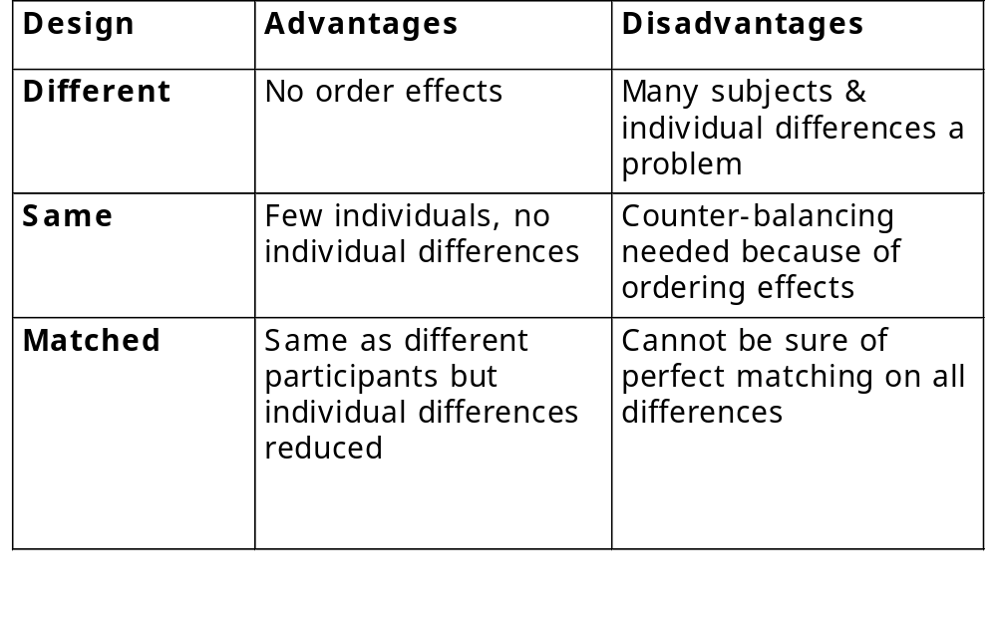
Advantages & disadvantages

Slide 13
Predictive models
Provide a way of evaluating products or designs without directly involving users
Psychological models of users are used to test designs
Less expensive than user testing
Usefulness limited to systems with predictable tasks - e.g., telephone answering systems, mobiles, etc.
Based on expert behavior

Slide 14
GOMS (Card et al., 1983)
Goals - the state the user wants to achieve e.g., find a website
Operators - the cognitive processes & physical actions performed to attain those goals, e.g., decide which search engine to use
Methods - the procedures for accomplishing the goals, e.g., drag mouse over field, type in keywords, press the go button
Selection rules - determine which method to select when there is more than one available

Slide 15
Keystroke level model
GOMS has also been developed further into a quantitative model - the keystroke level model.
This model allows predictions to be made about how long it takes an expert user to perform a task.

Slide 16
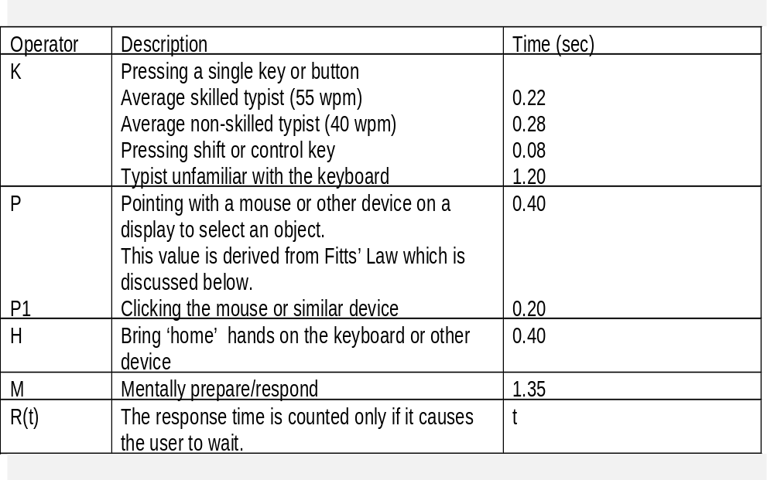
Response times for keystroke level operators (excerpt from .

Slide 17
Fitts’ Law (Paul Fitts 1954)
The law predicts that the time to point at an object using a device is a function of the distance from the target object & the object’s size.
The further away & the smaller the object, the longer the time to locate it and point.
Useful for evaluating systems for which the time to locate an object is important such
as handheld devices like mobile phones

Slide 18
Key points
User testing is a central part of usability testing
Testing is done in controlled conditions
User testing is an adapted form of experimentation
Experiments aim to test hypotheses by manipulating certain variables while keeping others constant
The experimenter controls the independent variable(s) but not the dependent variable(s)
There are three types of experimental design: different-participants, same- participants, & matched participants
GOMS, Keystroke level model, & Fitts’ Law predict expert, error-free performance
Predictive models are used to evaluate systems with predictable tasks such as telephones

Slide 19
A project for you …
Use the web and other resources to research Jakob Nielsen’s claims about the efficacy of heuristic evaluation and Bill Bailey’s complaints that heuristic evaluation often identifies problems that are not serious and may not even be problems at all.
Pretend that you are either Nielsen or Bailey and write a brief statement arguing your position.
Provide practical evidence & evidence from the literature to support your position.

Slide 20
A project for you …
Search the web for examples of the three different types of experimental designs.
Write a brief critique of each.

Slide 21
A Project for you …Fitts’ Law
Visit Tog’s website and do Tog’s quiz, designed to give you fitts!
http://www.asktog.com/columns/022DesignedToGiveFitts.html

